Slide 1

离散数学
Discrete Mathematics
钟芳明
离散数学
Discrete Mathematics

Slide 2
Chapter 2 Predicate logic
2.1 Predicate logic（谓词逻辑）

Slide 3
Content
Predicates, individuals, Quantifiers
Predicate formulas
Free variable & bound variable
Equivalence & tautology with quantifiers
Rules of Inference
Premix normal form, Skolem’s normal form

Slide 4
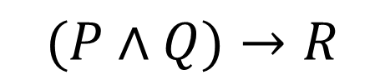
Predicate logic
基本概念和表示
个体、谓词
量词
合式谓词公式
自由变元和约束变元
谓词逻辑的解释与翻译
谓词公式的解释
谓词公式的翻译
等价式与蕴涵式
德摩根律
量词辖域扩张及收缩律
量词分配律
In propositional logic, try the following reasoning :
Fake“Socrates syllogism”：
All humans are lovely. P
Doctors are humans. Q
Therefore, Doctors are lovely. R
In propositional logic, propositions is regarded as a basic, indivisible unit, which only studies complex propositions composed of atomic propositions and conjunctions, and does not study the internal structure of propositions and the internal relations between propositions.
$$(P∧Q)→R$$
Not a tautology

Slide 5
Predicate logic
基本概念和表示
个体、谓词
量词
合式谓词公式
自由变元和约束变元
谓词逻辑的解释与翻译
谓词公式的解释
谓词公式的翻译
等价式与蕴涵式
德摩根律
量词辖域扩张及收缩律
量词分配律
There are many similar ones, for example ：
Everyone needs to breathe. Li Hua is a human, so Li Hua needs to breathe.
All positive integers are greater than 0, 3 is a positive integer, so 3 is greater than 0.
The predicate logic is introduced
The deeper relation between atomic propositions is investigated.
An atomic proposition is further analyzed into individuals(个体), predicates(谓词) and quantifiers(量词)
An abstract system is constructed just like that in propositional logic.

Slide 6
Predicate logic
Actually, it is to symbolize the logical argumentation in mathematics.
基本概念和表示
个体、谓词
量词
合式谓词公式
自由变元和约束变元
谓词逻辑的解释与翻译
谓词公式的解释
谓词公式的翻译
等价式与蕴涵式
德摩根律
量词辖域扩张及收缩律
量词分配律
Atomic proposition is devised into predicates（谓词） and individuals（个体）
individual：things that can exist independently， the described object .
teacher, computer, certification, morality, intelligence quotient, etc.
predicate：describing the property of an individual or the relationship among individuals
one variable : unary predicate（一元谓词）;
the relationship among n variables: n-ary predicate（n元谓词）.

Slide 7
Predicate & variable
基本概念和表示
个体、谓词
量词
合式谓词公式
自由变元和约束变元
谓词逻辑的解释与翻译
谓词公式的解释
谓词公式的翻译
等价式与蕴涵式
德摩根律
量词辖域扩张及收缩律
量词分配律
Example：
(1) Li Ming is a student;
(2) Li Dan is a student;
(3) Zhang Liang is higher than Chen Hua;
(4) Chen Hua sits between Zhang Liang and Li Ming
individual： Li Ming, Li Dan, Zhang Liang, Chen Hua
predicate：… is a student ； … is higher than …； … sits between … and …
1-ary Predicate： … is a student
2-ary Predicate： … is higher than …
3-ary Predicate： … sits between … and …

Slide 8
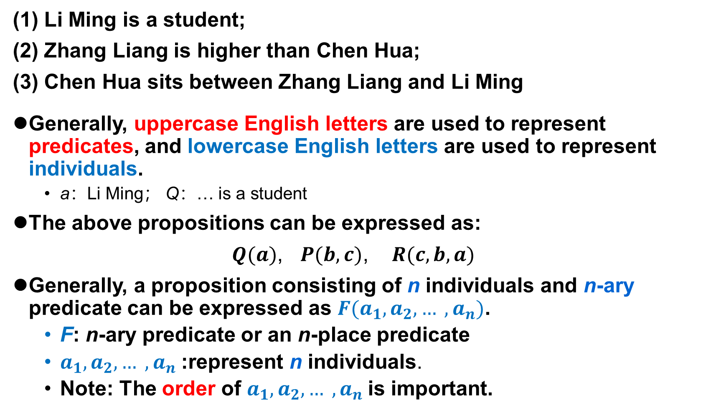
Predicate & variable
(1) Li Ming is a student;
(2) Zhang Liang is higher than Chen Hua;
(3) Chen Hua sits between Zhang Liang and Li Ming
Generally, uppercase English letters are used to represent predicates, and lowercase English letters are used to represent individuals.
a：Li Ming； Q：… is a student
The above propositions can be expressed as:
$Q(a)$, $P(b,c)$, $R(c,b,a)$
Generally, a proposition consisting of n individuals and n-ary predicate can be expressed as $F(a_{1},a_{2}, … ,a_{n})$.
F: n-ary predicate or an n-place predicate
$a_{1},a_{2}, … ,a_{n}$:represent n individuals.
Note: The order of $a_{1},a_{2}, … ,a_{n}$is important.
基本概念和表示
个体、谓词
量词
合式谓词公式
自由变元和约束变元
谓词逻辑的解释与翻译
谓词公式的解释
谓词公式的翻译
等价式与蕴涵式
德摩根律
量词辖域扩张及收缩律
量词分配律

Slide 9
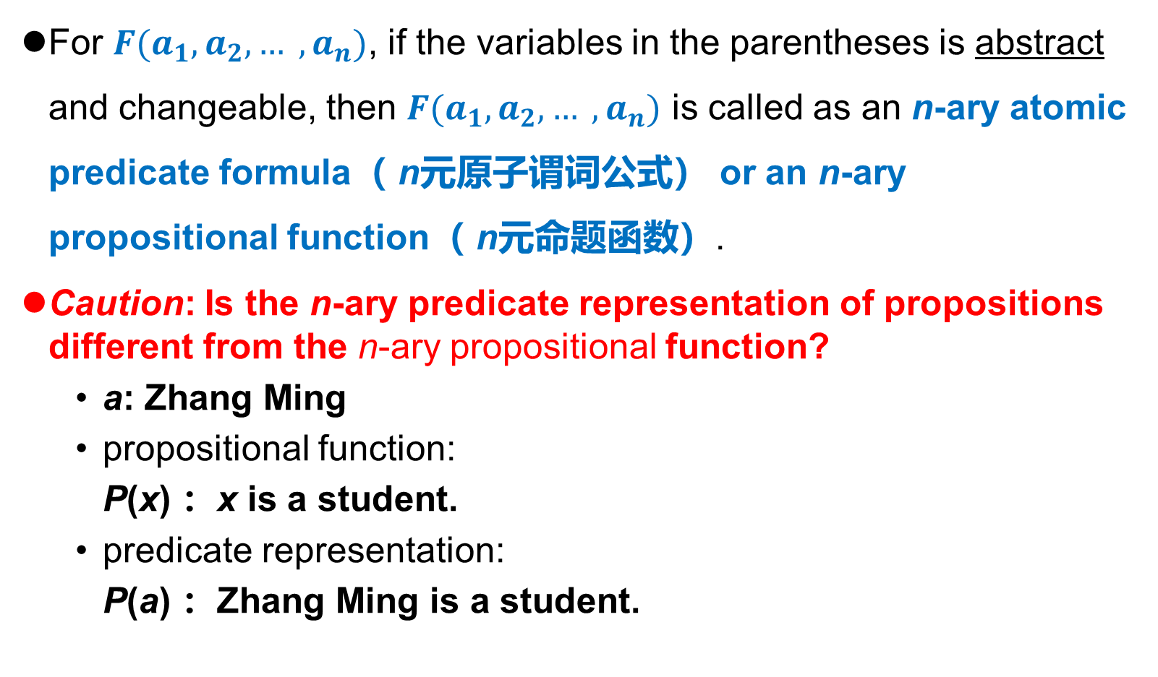
Predicate & variable
For $F(a_{1},a_{2}, … ,a_{n})$, if the variables in the parentheses is abstract and changeable, then $F(a_{1},a_{2}, … ,a_{n})$ is called as an n-ary atomic predicate formula（ n元原子谓词公式） or an n-ary propositional function（ n元命题函数）.
Caution: Is the n-ary predicate representation of propositions different from the n-ary propositional function?
a: Zhang Ming
propositional function:
P(x) ：x is a student.
predicate representation:
P(a) ：Zhang Ming is a student.
基本概念和表示
个体、谓词
量词
合式谓词公式
自由变元和约束变元
谓词逻辑的解释与翻译
谓词公式的解释
谓词公式的翻译
等价式与蕴涵式
德摩根律
量词辖域扩张及收缩律
量词分配律

Slide 10
Domain of discourse（个体域，论域）
基本概念和表示
个体、谓词
量词
合式谓词公式
自由变元和约束变元
谓词逻辑的解释与翻译
谓词公式的解释
谓词公式的翻译
等价式与蕴涵式
德摩根律
量词辖域扩张及收缩律
量词分配律
For all values of a variable in a particular domain, called the domain of discourse (or the universe of discourse)
Domain of discourse can be finite or infinite. The sum of all domains is called the universal domain of discourse. A variable in a particular domain is called individual variable.
The meaning of P(x) changes when the domain is changed
R(x)： x is a student belonging to School of Software Technology in Dalian University of Technology ．
If the domain of x is the student of a certain class in School of Software Technology
If the domain of x is the children in a kindergarten
If the domain of x is all citizens of Dalian
Tautology
Contradiction
Satisfiable

Slide 11
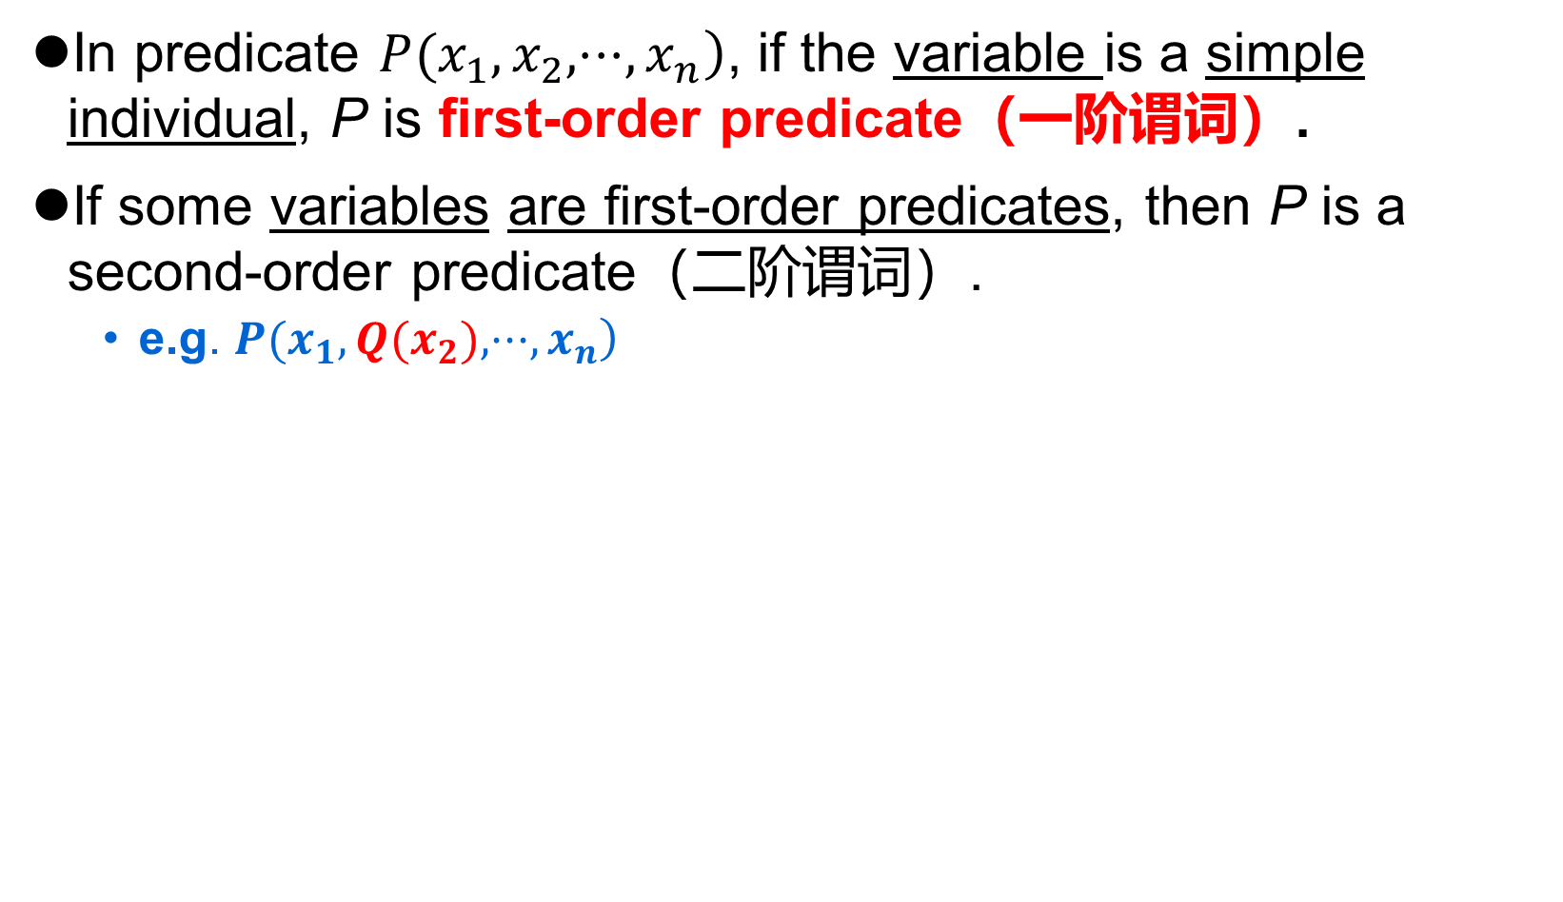
The ORDER of predicate
基本概念和表示
个体、谓词
量词
合式谓词公式
自由变元和约束变元
谓词逻辑的解释与翻译
谓词公式的解释
谓词公式的翻译
等价式与蕴涵式
德摩根律
量词辖域扩张及收缩律
量词分配律
In predicate $\left.P(x_{1},x_{2},⋅⋅⋅,x_{n}\right)$, if the variable is a simple individual, P is first-order predicate（一阶谓词）.
If some variables are first-order predicates, then P is a second-order predicate（二阶谓词）.
e.g. $\left.P(x_{1},Q(x_{2}),⋅⋅⋅,x_{n}\right)$
This course only studies first-order predicates

Slide 12
Quantifiers（量词）
基本概念和表示
个体、谓词
量词
合式谓词公式
自由变元和约束变元
谓词逻辑的解释与翻译
谓词公式的解释
谓词公式的翻译
等价式与蕴涵式
德摩根律
量词辖域扩张及收缩律
量词分配律
Using the predicates and variables introduced earlier is not enough to describe all the propositions in the nature.
For example ：
Describe the proposition "all positive integers are greater than 0"
Describe the proposition "some positive integers are prime numbers"
Quantifiers are the words that represent the quantity in a proposition.

Slide 13
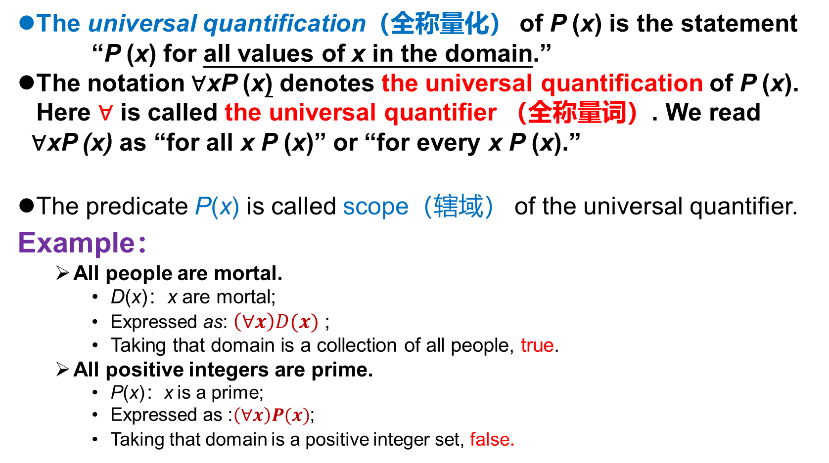
UNIVERSAL QUANTIFIER ∀
基本概念和表示
个体、谓词
量词
合式谓词公式
自由变元和约束变元
谓词逻辑的解释与翻译
谓词公式的解释
谓词公式的翻译
等价式与蕴涵式
德摩根律
量词辖域扩张及收缩律
量词分配律
The universal quantification（全称量化） of P (x) is the statement “P (x) for all values of x in the domain.”
The notation ∀xP (x) denotes the universal quantification of P (x). Here ∀ is called the universal quantifier （全称量词）. We read
∀xP (x) as “for all x P (x)” or “for every x P (x).”
The predicate P(x) is called scope（辖域） of the universal quantifier.
Example：
All people are mortal.
D(x)：x are mortal;
Expressed as: $\left(∀x\right)D(x)$ ;
Taking that domain is a collection of all people, true.
All positive integers are prime.
P(x)：x is a prime;
Expressed as :$\left(∀x\right)P(x)$;
Taking that domain is a positive integer set, false.
Notes:
An element for which P(x) is false is called a counterexample of ∀xP(x).

Slide 14
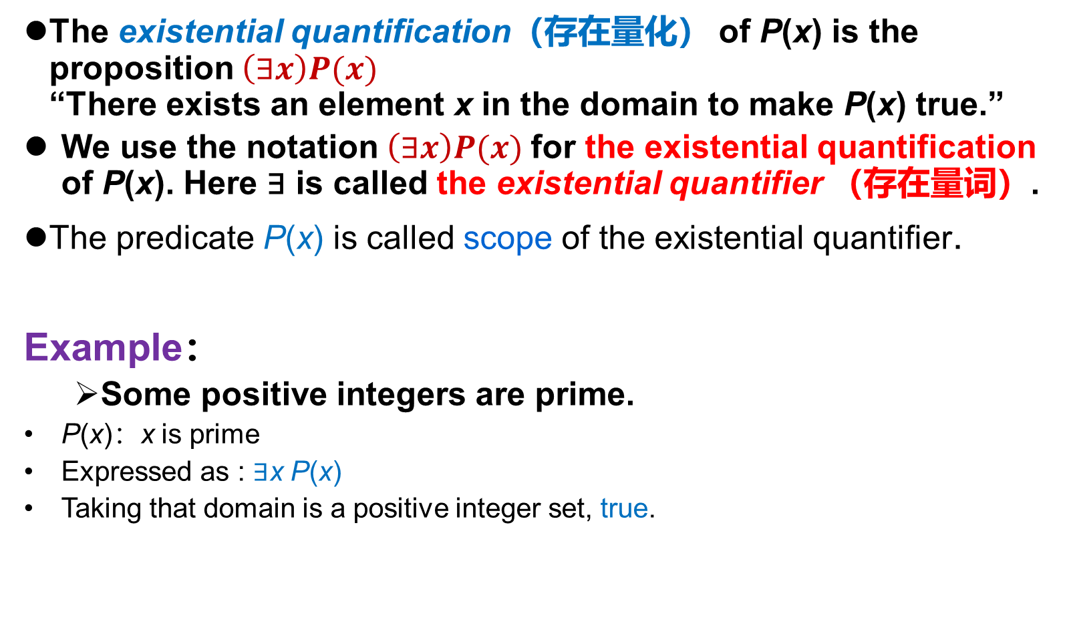
EXISTENTIAL QUANTIFIER ∃
基本概念和表示
个体、谓词
量词
合式谓词公式
自由变元和约束变元
谓词逻辑的解释与翻译
谓词公式的解释
谓词公式的翻译
等价式与蕴涵式
德摩根律
量词辖域扩张及收缩律
量词分配律
The existential quantification（存在量化） of P(x) is the proposition $\left(∃x\right)P(x)$ “There exists an element x in the domain to make P(x) true.”
We use the notation $\left(∃x\right)P(x)$for the existential quantification of P(x). Here ∃ is called the existential quantifier （存在量词）.
The predicate P(x) is called scope of the existential quantifier.
Example：
Some positive integers are prime.
P(x)：x is prime
Expressed as : ∃x P(x)
Taking that domain is a positive integer set, true.
Notes:
质数

Slide 15
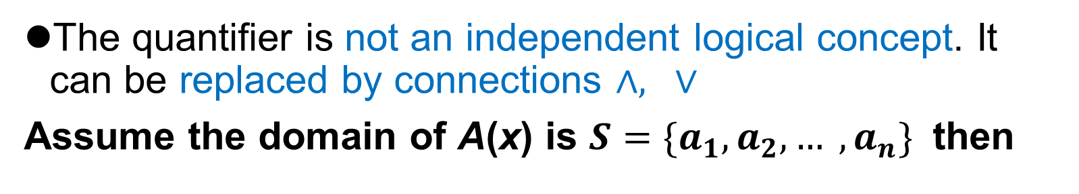
Quantifiers
基本概念和表示
个体、谓词
量词
合式谓词公式
自由变元和约束变元
谓词逻辑的解释与翻译
谓词公式的解释
谓词公式的翻译
等价式与蕴涵式
德摩根律
量词辖域扩张及收缩律
量词分配律
The quantifier is not an independent logical concept. It can be replaced by connections $∧, ∨$
Assume the domain of A(x) is $S=\{a_{1},a_{2}, … ,a_{n}\}$ then
The true value of proposition determined by quantifiers is related to the domain.
P(x)：x is prime.
∀x P(x): if the domain is a prime set，TRUE；if the domain is an integer set，FALSE。

Slide 16
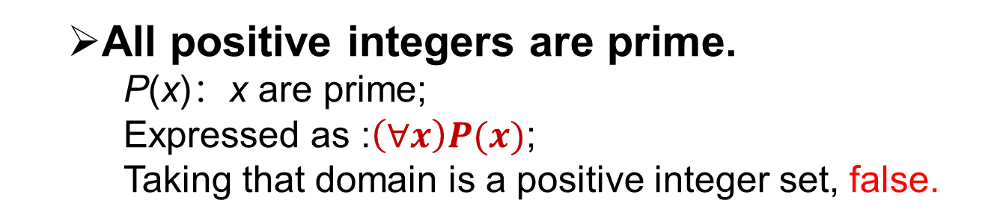
Quantifiers
For convenience, domains are universal domains(全总个体域), and the range of each variable is described by a characteristic predicate.
基本概念和表示
个体、谓词
量词
合式谓词公式
自由变元和约束变元
谓词逻辑的解释与翻译
谓词公式的解释
谓词公式的翻译
等价式与蕴涵式
德摩根律
量词辖域扩张及收缩律
量词分配律
All positive integers are prime.
P(x)：x are prime;
Expressed as :$\left(∀x\right)P(x)$;
Taking that domain is a positive integer set, false.
Domain: All real numbers
Q(x)：x is a positive integer

Slide 17
The domains that are not emphasized are all universal domains
Quantifiers
For convenience, domains are universal domains(全总个体域), and the range of each variable is described by a characteristic predicate.
Note: for universal quantifier, we should use single conditional logical connectives; for existential quantifier, we should use logical conjunction.
R(x): x is a natural number；
P(x): x is greater than 0.
基本概念和表示
个体、谓词
量词
合式谓词公式
自由变元和约束变元
谓词逻辑的解释与翻译
谓词公式的解释
谓词公式的翻译
等价式与蕴涵式
德摩根律
量词辖域扩张及收缩律
量词分配律

Slide 18
Quantifiers
基本概念和表示
个体、谓词
量词
合式谓词公式
自由变元和约束变元
谓词逻辑的解释与翻译
谓词公式的解释
谓词公式的翻译
等价式与蕴涵式
德摩根律
量词辖域扩张及收缩律
量词分配律
The quantifiers ∀ and ∃ have higher precedence than all logical connectives. For example, ∀xP(x) ∨ Q(x).
The universal quantifier and the existential quantifier not only can be used alone, but also can be nested.
For 2-ary predicate P(x, y) , there may be several representations to be quantified：
∀x∃y(x + y = 0)
For every real number x there is a real number y such that x + y = 0.

Slide 19
Nested Quantifiers
Translation form
left to right
基本概念和表示
个体、谓词
量词
合式谓词公式
自由变元和约束变元
谓词逻辑的解释与翻译
谓词公式的解释
谓词公式的翻译
等价式与蕴涵式
德摩根律
量词辖域扩张及收缩律
量词分配律
Suppose A(x,y): x has the same surname with y. The domain of x is a student in 1-st class, The domain of y is a student in 2-nd class.
：All students in 1-st class have the same surname with all students in 2-nd class.
：All students in 2-nd class have the same surname with all students in 1-st class.
：For any student in 1-st class, there exists student who has same surname with him in class 2.
：There exists a student in 2-nd class has the same surname with all students in 1-st class.
$$\left(∀x)(∃y)A(x,y)≠(∃y)(∀x)A(x,y\right)$$

Slide 20
Nested Quantifiers
基本概念和表示
个体、谓词
量词
合式谓词公式
自由变元和约束变元
谓词逻辑的解释与翻译
谓词公式的解释
谓词公式的翻译
等价式与蕴涵式
德摩根律
量词辖域扩张及收缩律
量词分配律
It is important to note that the order of the quantifiers is important, unless all the quantifiers are universal quantifiers or all are existential quantifiers.
Example: Let P(x, y) be the statement “x + y = y + x.” What are the truth values of the quantifications ∀x∀yP(x, y) and ∀y∀xP(x, y) where the domain for all variables consists of all real numbers?
Example: Let Q(x, y) denote “x + y = 0.” What are the truth values of the quantifications ∃y∀xQ(x, y) and ∀x∃yQ(x, y), where the domain for all variables consists of all real numbers?

Slide 21
Compound predicate formula（合式谓词公式）
基本概念和表示
个体、谓词
量词
合式谓词公式
自由变元和约束变元
谓词逻辑的解释与翻译
谓词公式的解释
谓词公式的翻译
等价式与蕴涵式
德摩根律
量词辖域扩张及收缩律
量词分配律
If P is an unfactorized n-ary variable predicate, and x₁,x₂,…, x_{n} are variables, P(x₁, x₂,…x_{n}) is atomic formula or atomic predicate formula.
When n=0, P denotes a propositional variable, that is, an atomic propositional formula. Actually, propositional logic is a special case of predicate logic.
Combined the atomic predicate formula and propositional conjunction, we can form a compound predicate formula called molecular/compound predicate formula.
Notes:
that is, a sentence that declares a fact
Ottawa

Slide 22
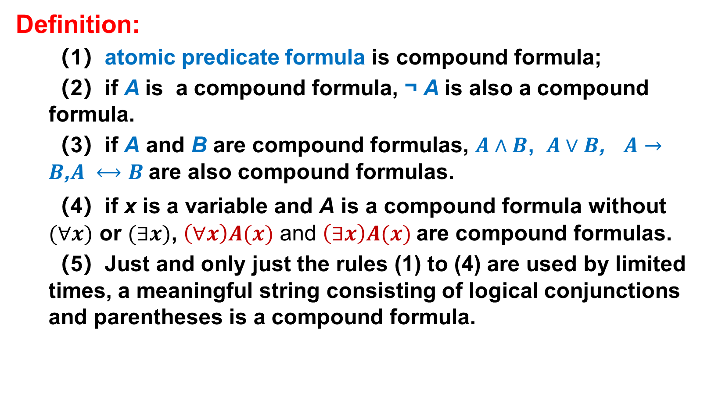
Compound predicate formula
基本概念和表示
个体、谓词
量词
合式谓词公式
自由变元和约束变元
谓词逻辑的解释与翻译
谓词公式的解释
谓词公式的翻译
等价式与蕴涵式
德摩根律
量词辖域扩张及收缩律
量词分配律
Definition:
（1）atomic predicate formula is compound formula;
（2）if A is a compound formula, ¬ A is also a compound formula.
（3）if A and B are compound formulas, $A∧B$, $A∨B$, $A→B$,$A ⟷B$are also compound formulas.
（4）if x is a variable and A is a compound formula without $(∀x)$ or $(∃x)$, $\left(∀x\right)A(x)$ and $\left(∃x\right)A(x)$are compound formulas.
（5）Just and only just the rules (1) to (4) are used by limited times, a meaningful string consisting of logical conjunctions and parentheses is a compound formula.
Notes:
that is, a sentence that declares a fact
Ottawa

Slide 23
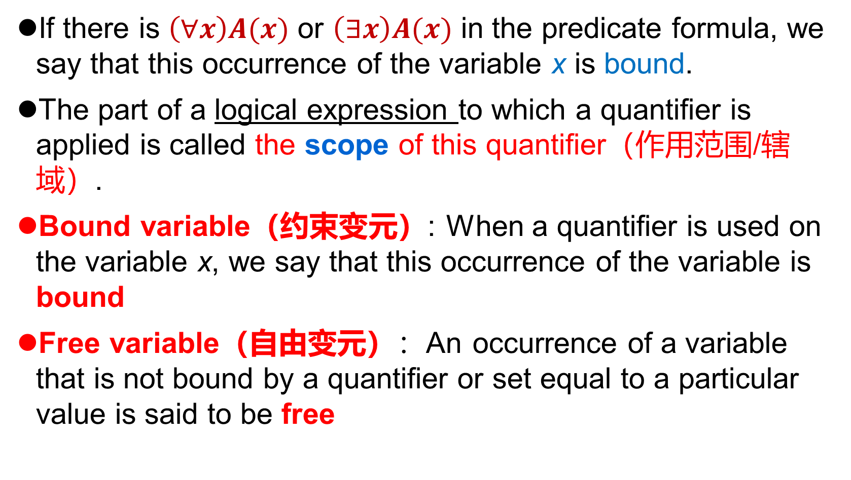
Free variable & bound variable
基本概念和表示
个体、谓词
量词
合式谓词公式
自由变元和约束变元
谓词逻辑的解释与翻译
谓词公式的解释
谓词公式的翻译
等价式与蕴涵式
德摩根律
量词辖域扩张及收缩律
量词分配律
If there is $\left(∀x\right)A(x)$ or $\left(∃x\right)A(x)$ in the predicate formula, we say that this occurrence of the variable x is bound.
The part of a logical expression to which a quantifier is applied is called the scope of this quantifier（作用范围/辖域）.
Bound variable（约束变元）: When a quantifier is used on the variable x, we say that this occurrence of the variable is bound
Free variable（自由变元）：An occurrence of a variable that is not bound by a quantifier or set equal to a particular value is said to be free

Slide 24
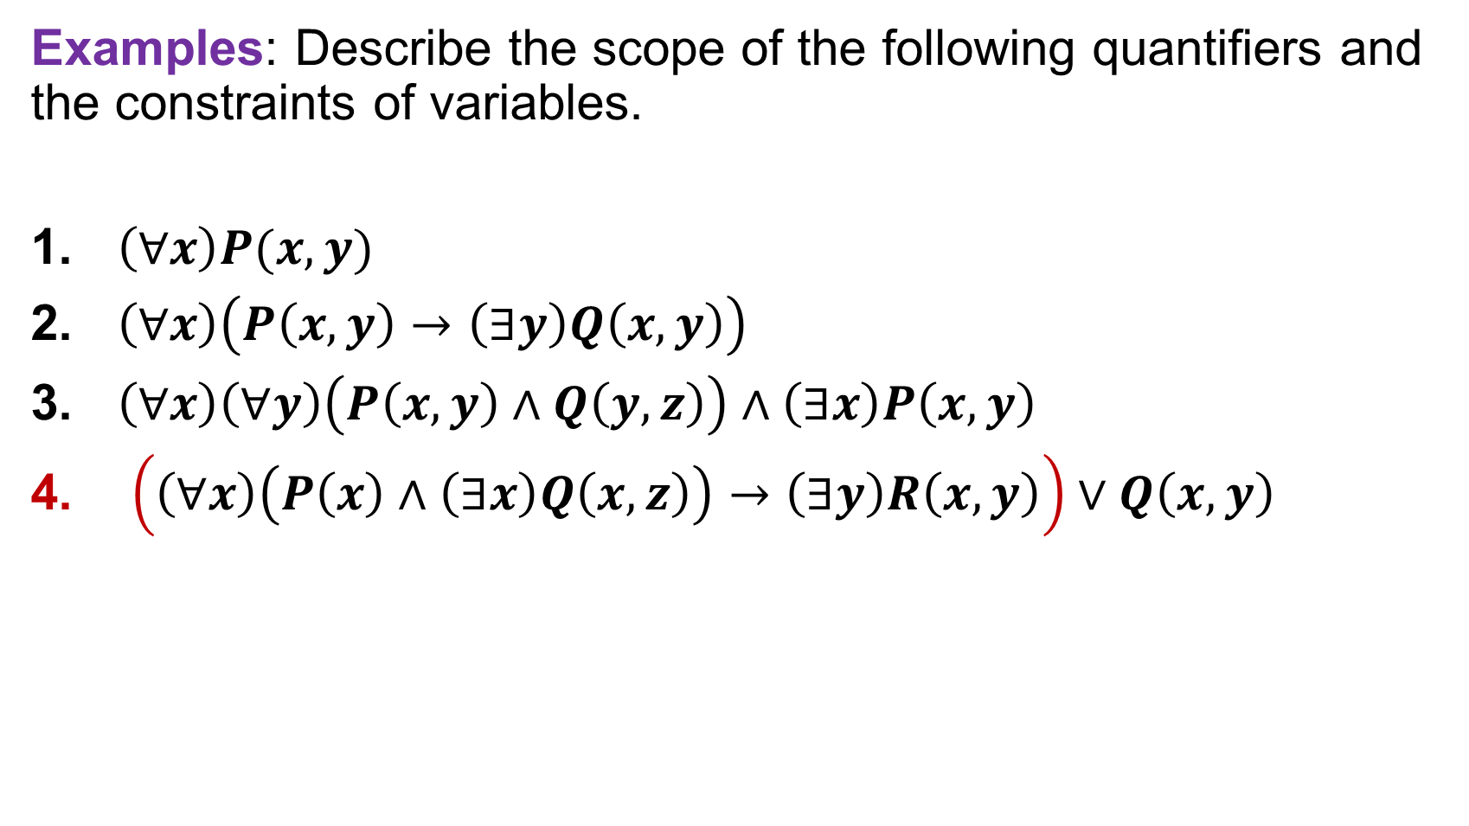
Free variable & bound variable
基本概念和表示
个体、谓词
量词
合式谓词公式
自由变元和约束变元
谓词逻辑的解释与翻译
谓词公式的解释
谓词公式的翻译
等价式与蕴涵式
德摩根律
量词辖域扩张及收缩律
量词分配律
Examples: Describe the scope of the following quantifiers and the constraints of variables.
$\left(∀x\right)P(x,y)$
$\left(∀x\right)\left(P\left(x,y\right)→\left(∃y\right)Q\left(x,y\right)\right)$
$\left(∀x\right)\left(∀y\right)\left(P\left(x,y\right)∧Q\left(y,z\right)\right)∧\left(∃x\right)P\left(x,y\right)$
$\left(\left(∀x\right)\left(P\left(x\right)∧\left(∃x\right)Q\left(x,z\right)\right)→\left(∃y\right)R\left(x,y\right)\right)∨Q\left(x,y\right)$

Slide 25
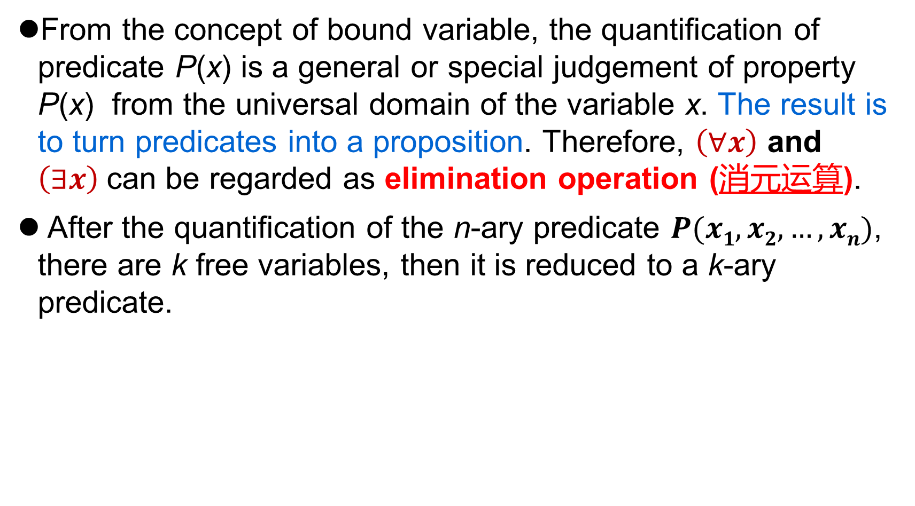
Free variable & bound variable
基本概念和表示
个体、谓词
量词
合式谓词公式
自由变元和约束变元
谓词逻辑的解释与翻译
谓词公式的解释
谓词公式的翻译
等价式与蕴涵式
德摩根律
量词辖域扩张及收缩律
量词分配律
From the concept of bound variable, the quantification of predicate P(x) is a general or special judgement of property P(x) from the universal domain of the variable x. The result is to turn predicates into a proposition. Therefore, $\left(∀x\right)$ and $\left(∃x\right)$can be regarded as elimination operation (消元运算).
After the quantification of the n-ary predicate $P(x1, x2,…, xn)$, there are k free variables, then it is reduced to a k-ary predicate.
2-ary predicate
1-ary predicate

Slide 26
Free variable & bound variable
基本概念和表示
个体、谓词
量词
合式谓词公式
自由变元和约束变元
谓词逻辑的解释与翻译
谓词公式的解释
谓词公式的翻译
等价式与蕴涵式
德摩根律
量词辖域扩张及收缩律
量词分配律
Given a predicate formula A(x), it only indicates that there is only one free variable in the formula, but there are no restrictions about the number of bound variables.
The following formulas can be written as A(x)：
Notes:
that is, a sentence that declares a fact
Ottawa

Slide 27
Explanation(解释) of predicate formula
基本概念和表示
个体、谓词
量词
合式谓词公式
自由变元和约束变元
谓词逻辑的解释与翻译
谓词公式的解释
谓词公式的翻译
等价式与蕴涵式
德摩根律
量词辖域扩张及收缩律
量词分配律
In propositional logic, the explanation of a formula is to assign values to each propositional variable. If the formula has n variables, there are 2^{n} explanations.
The explanation of predicate formula involves propositional variables, predicate variables, individual variables, and functions……
Truth table method is infeasible

Slide 28
Explanation of predicate formula
基本概念和表示
个体、谓词
量词
合式谓词公式
自由变元和约束变元
谓词逻辑的解释与翻译
谓词公式的解释
谓词公式的翻译
等价式与蕴涵式
德摩根律
量词辖域扩张及收缩律
量词分配律
Definition：Set the domain of A is D. If a set of predicate constants, propositional constants, individuals and function symbols in D (denoted as I ) are used to replace the corresponding variables in formula A, formula A is transformed into a proposition and its truth value (denoted as P) can be determined. I is an explanation (or assignment) of the formula A in D, and P is the truth value of the formula A with respect to the explanation I.
Tautology
Contradiction
Satisfiable

Slide 29
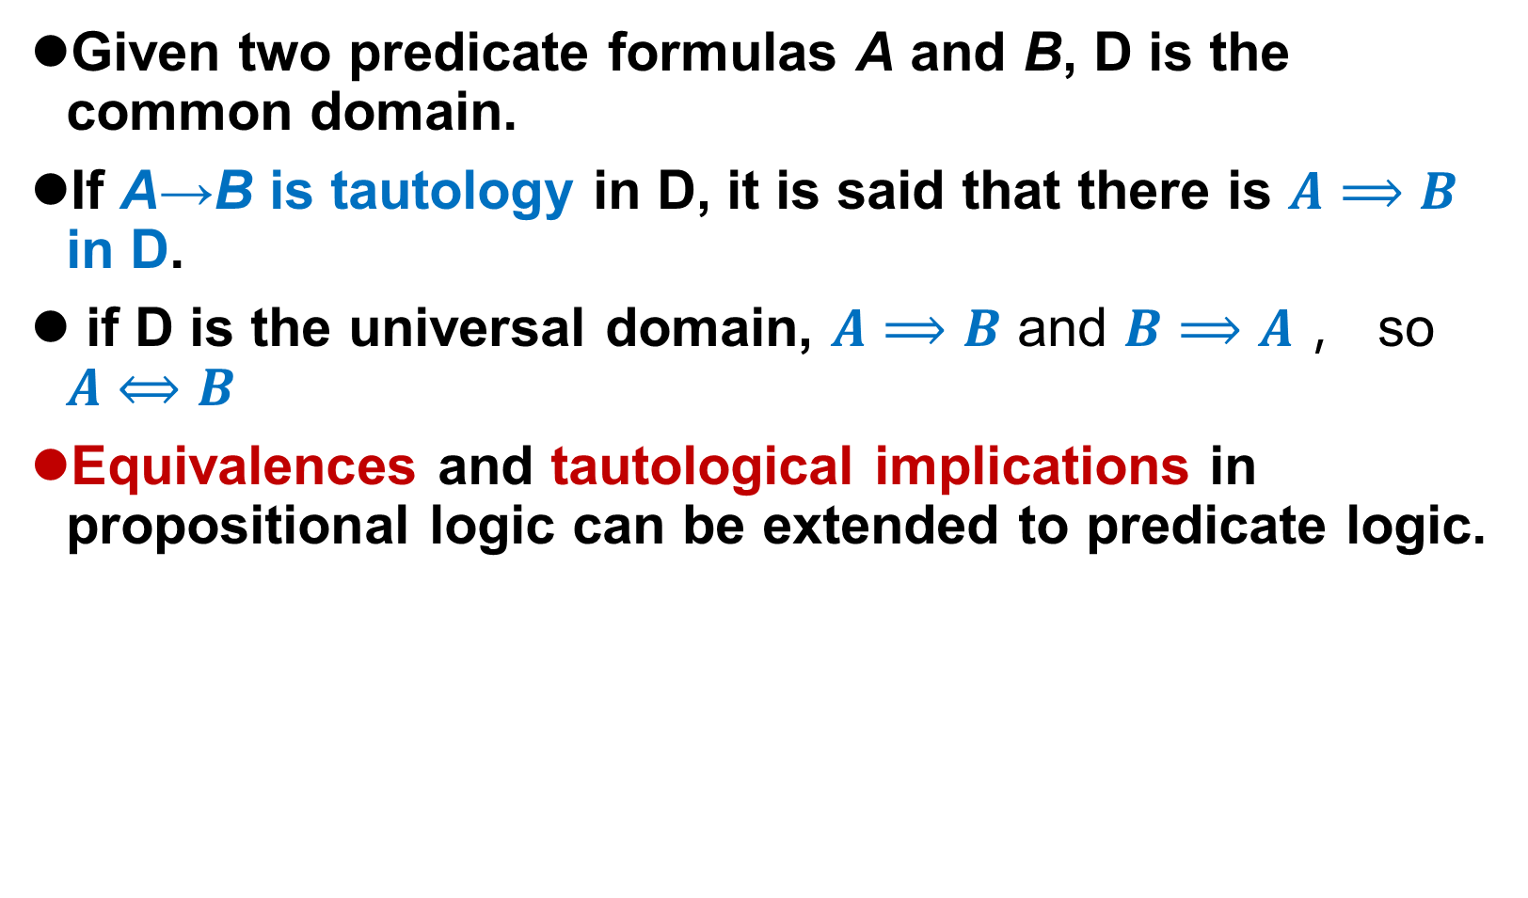
Explanation of predicate formula
基本概念和表示
个体、谓词
量词
合式谓词公式
自由变元和约束变元
谓词逻辑的解释与翻译
谓词公式的解释
谓词公式的翻译
等价式与蕴涵式
德摩根律
量词辖域扩张及收缩律
量词分配律
Given two predicate formulas A and B, D is the common domain.
If A→B is tautology in D, it is said that there is $A⟹B$ in D.
if D is the universal domain, $A⟹B$ and $B⟹A$， so $A⟺B$
Equivalences and tautological implications in propositional logic can be extended to predicate logic.

Slide 30
Equivalence and tautological implication with quantifiers
基本概念和表示
个体、谓词
量词
合式谓词公式
自由变元和约束变元
谓词逻辑的解释与翻译
谓词公式的解释
谓词公式的翻译
等价式与蕴涵式
德摩根律
量词辖域扩张及收缩律
量词分配律
De Morgan’s Laws for Quantifiers.
Example：P(x)：x comes to class today. All students of class A.
All students come to class today.
Not everyone comes to class today.
There is someone doesn’t come to class today.
There is someone comes to class today.
Nobody comes to class today.
All students don’t come to class today.

Slide 31
De Morgan’s Laws for Quantifiers.
基本概念和表示
个体、谓词
量词
合式谓词公式
自由变元和约束变元
谓词逻辑的解释与翻译
谓词公式的解释
谓词公式的翻译
等价式与蕴涵式
德摩根律
量词辖域扩张及收缩律
量词分配律
（ Where A(x) is an arbitrary formula ）
Proof: Set domain ,
Notes:
Precedence higher than Negation

Slide 32
Scope Expansion and Contraction
基本概念和表示
个体、谓词
量词
合式谓词公式
自由变元和约束变元
谓词逻辑的解释与翻译
谓词公式的解释
谓词公式的翻译
等价式与蕴涵式
德摩根律
量词辖域扩张及收缩律
量词分配律
Notice: The bound variable x is not in P.
Proof: only for the first formula, the rest are analogous.

Slide 33
Distributive laws of quantifiers
基本概念和表示
个体、谓词
量词
合式谓词公式
自由变元和约束变元
谓词逻辑的解释与翻译
谓词公式的解释
谓词公式的翻译
等价式与蕴涵式
德摩根律
量词辖域扩张及收缩律
量词分配律
we can distribute a universal quantifier over a conjunction. Furthermore, we can also distribute an existential quantifier over a disjunction.
Proof: Only the first formula is proved.

Slide 34
Distributive laws of quantifiers
We cannot distribute a universal quantifier over a disjunction, nor can we distribute an existential quantifier over a conjunction.
Example：Domain is a set of people.
A(x)：x is female. B(x)：x is male
基本概念和表示
个体、谓词
量词
合式谓词公式
自由变元和约束变元
谓词逻辑的解释与翻译
谓词公式的解释
谓词公式的翻译
等价式与蕴涵式
德摩根律
量词辖域扩张及收缩律
量词分配律
True.
False
False
True.
Just satisfied:
understand the second formula above. Supposed:
A(x): x will use his left hand to hold chopsticks.
B(x): x will use his right hand to hold chopsticks.

Slide 35
Important Equivalence & tautology
基本概念和表示
个体、谓词
量词
合式谓词公式
自由变元和约束变元
谓词逻辑的解释与翻译
谓词公式的解释
谓词公式的翻译
等价式与蕴涵式
德摩根律
量词辖域扩张及收缩律
量词分配律
等价式与蕴含式

Slide 36
Important Equivalence & tautology
基本概念和表示
个体、谓词
量词
合式谓词公式
自由变元和约束变元
谓词逻辑的解释与翻译
谓词公式的解释
谓词公式的翻译
等价式与蕴涵式
德摩根律
量词辖域扩张及收缩律
量词分配律
等价式与蕴含式

Slide 37
Important Implications
基本概念和表示
个体、谓词
量词
合式谓词公式
自由变元和约束变元
谓词逻辑的解释与翻译
谓词公式的解释
谓词公式的翻译
等价式与蕴涵式
德摩根律
量词辖域扩张及收缩律
量词分配律
等价式与蕴含式

Slide 38
Quantifier exchange law
基本概念和表示
个体、谓词
量词
合式谓词公式
自由变元和约束变元
谓词逻辑的解释与翻译
谓词公式的解释
谓词公式的翻译
等价式与蕴涵式
德摩根律
量词辖域扩张及收缩律
量词分配律
等价式与蕴含式

Slide 39
The law for memory
基本概念和表示
个体、谓词
量词
合式谓词公式
自由变元和约束变元
谓词逻辑的解释与翻译
谓词公式的解释
谓词公式的翻译
等价式与蕴涵式
德摩根律
量词辖域扩张及收缩律
量词分配律
等价式与蕴含式

Slide 40
Translation of predicate formula
基本概念和表示
个体、谓词
量词
合式谓词公式
自由变元和约束变元
谓词逻辑的解释与翻译
谓词公式的解释
谓词公式的翻译
等价式与蕴涵式
德摩根律
量词辖域扩张及收缩律
量词分配律
等价式与蕴含式
Every integer is a real number.
P(x)：x is an integer.
Q(x)：x is a real number.
Symbolized：
There is no person who doesn't make mistakes.
P(x)：x is a person.
Q(x)：x makes mistakes.
Symbolized :
Or：

Slide 41
Translation of predicate formula
基本概念和表示
个体、谓词
量词
合式谓词公式
自由变元和约束变元
谓词逻辑的解释与翻译
谓词公式的解释
谓词公式的翻译
等价式与蕴涵式
德摩根律
量词辖域扩张及收缩律
量词分配律
等价式与蕴含式
There is an even number greater than 10.
P(x)：x is greater than 10.
Q(x)：x is an even number.
Symbolized:
Every student should exercise.
P(x)：x is a student.
Q(x)：x exercises.
Symbolized:
Incorrect：
Notes:
All people are students and do exercise.

Slide 42
Translation of predicate formula
基本概念和表示
个体、谓词
量词
合式谓词公式
自由变元和约束变元
谓词逻辑的解释与翻译
谓词公式的解释
谓词公式的翻译
等价式与蕴涵式
德摩根律
量词辖域扩张及收缩律
量词分配律
等价式与蕴含式
Some lions do not like drinking coffee.
P(x)：x is a lion.
Q(x)：x likes drinking coffee.
Symbolized:
Incorrect :
which is true when there is an animal (not lion), in that case, for such an animal x, P(x) →¬ Q(x) becomes either F→T or F→F, both of which are true, even every lion drinks coffee.
Notes:
Truth values are different
X is not a lion can be true.

Slide 43
Translation of predicate formula
基本概念和表示
个体、谓词
量词
合式谓词公式
自由变元和约束变元
谓词逻辑的解释与翻译
谓词公式的解释
谓词公式的翻译
等价式与蕴涵式
德摩根律
量词辖域扩张及收缩律
量词分配律
等价式与蕴含式
No matter black cats or white cats, the ones who catch mice are good cats.
P(x)：x is a black cat.
Q(x)：x is a white cat.
R(x)：x is a cat who catches mice.
G(x)：x is a good cat.
Symbolized:
Some people are allergic to certain foods.
A(x)：x is a people.
B(x)：x is food.
C(x, y)：x is allergic to y.
Symbolized:

Slide 44
Translation of predicate formula
基本概念和表示
个体、谓词
量词
合式谓词公式
自由变元和约束变元
谓词逻辑的解释与翻译
谓词公式的解释
谓词公式的翻译
等价式与蕴涵式
德摩根律
量词辖域扩张及收缩律
量词分配律
等价式与蕴含式
All persons are not as tall as the other.
P(x)：x is a person.
Q(x,y)：x is as tall as y.
R(x,y)：x is not same as y.
Symbolized:
It is not true that everyone is as tall as others.
Symbolized:
or：

Slide 45
Translation of predicate formula
基本概念和表示
个体、谓词
量词
合式谓词公式
自由变元和约束变元
谓词逻辑的解释与翻译
谓词公式的解释
谓词公式的翻译
等价式与蕴涵式
德摩根律
量词辖域扩张及收缩律
量词分配律
等价式与蕴含式
Symbolized: There is no hero who only loves Rivers and Mountains but does not love beauties.
Hero(x)：x is a Hero.
Love(x, y)：x loves y.
Symbolized ：
OR
45/30

Slide 46
Summarization
Tips
What is Predicate
Predicate formula
Free and bound variable
Quantifier
Important Equivalence && tautology

Slide 47
Homework
P47
1,2

Slide 48
Up Next …
Next Lecture
Inference for Predicate Logic
Rules of Inference

Slide 49

The End
Thanks

